Slide 1
eXtensible Business Reporting Language

Slide 2
Agenda
What is XBRL
Key features of XBRL
Individual project

Slide 3
What is XBRL?
  eXtensible Business Reporting Language (XBRL) is a language for electronic communication of business data
  It allows companies to report financial information in a structured, machine-readable format

Slide 4
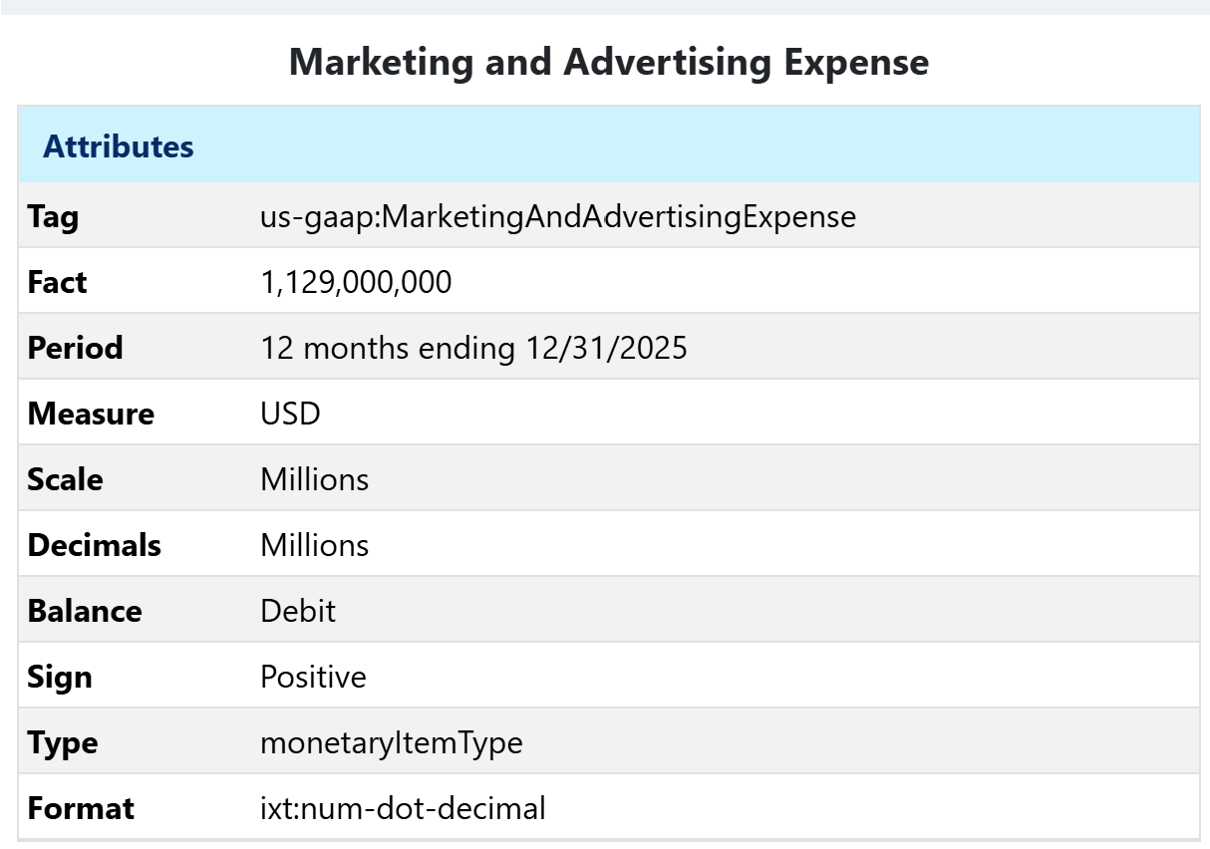
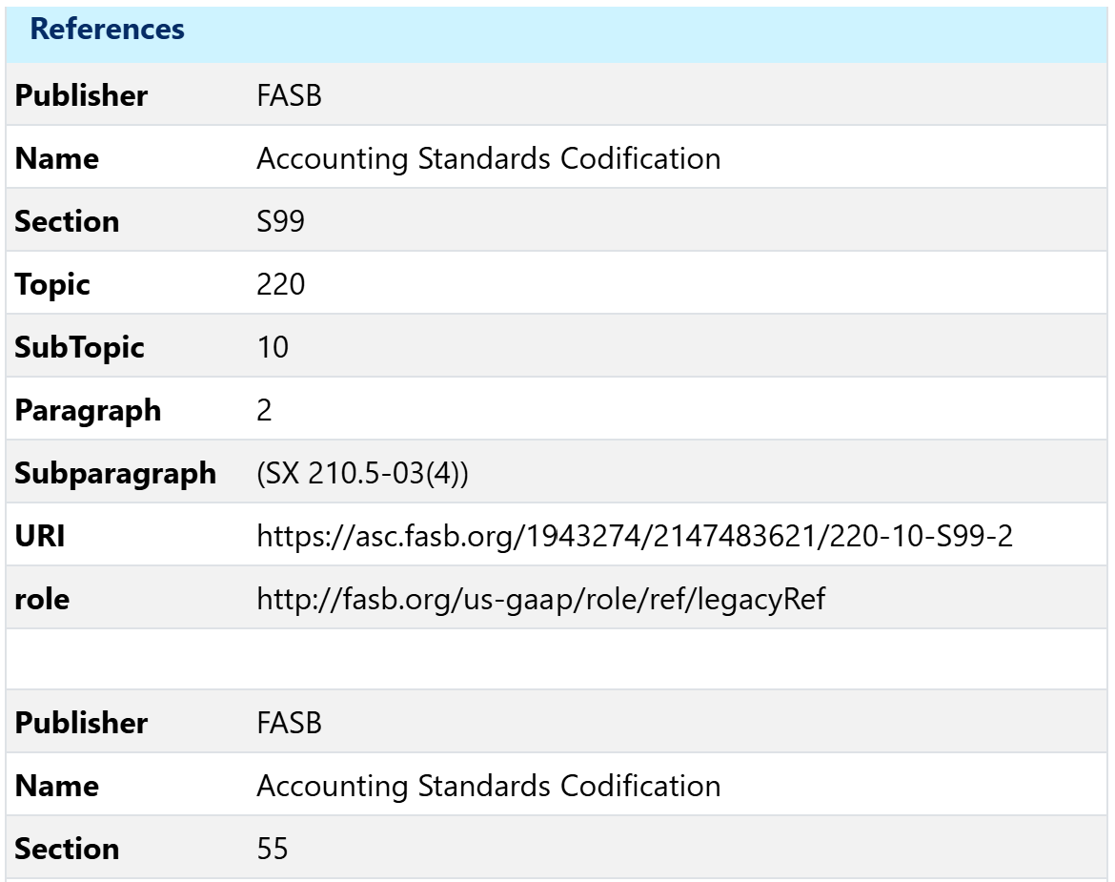
An Example of XBRL

Slide 5
XBRL Tags
  An XBRL tag is a standardized, machine-readable label applied to a specific piece of financial data
  A tag can be
  A standard/taxonomy tag from the XBRL taxonomy
  An extension/custom tag created by the firm

Slide 6
The Benefit of Tag Standardization
  Tag standardization can make it easier to compare accounting numbers across firms
  Example: net PPE reported by Costco vs. IBM
  What are the pros and cons of allowing custom tags?

Slide 7
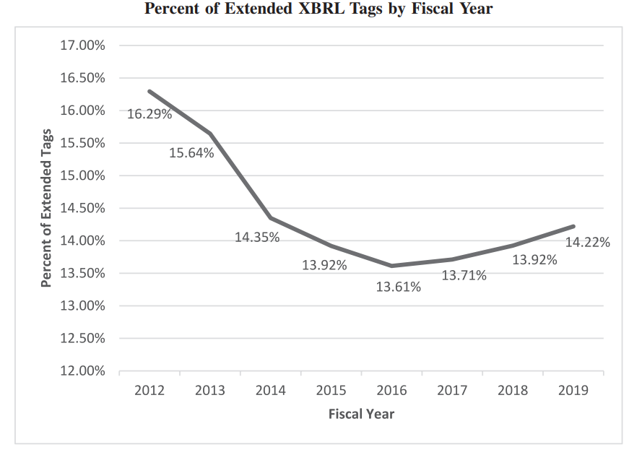
Extended XBRL Tags Trends
Notes:
Source: Hoitash et al. (2021) eXtensible Business Reporting Language (XBRL): A Review and Implications for Future Research, AUDITING: A JOURNAL OF PRACTICE & THEORY Vol 40.2 pp.107-132

Slide 8
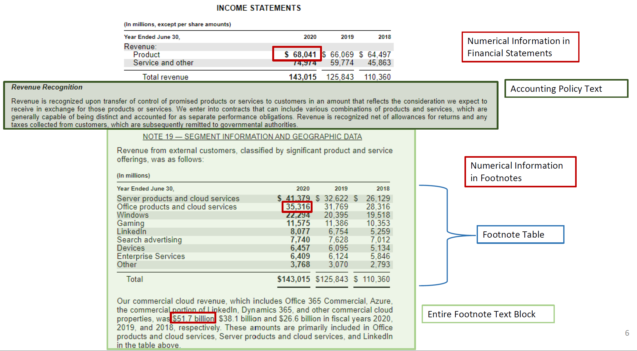
What Information Gets Tagged?
Notes:
Source: XBRL in Academic Research: A Workshop on How to Pull XBRL Data (Blankespoor et al. 2021).

Slide 9
Institutions Influencing XBRL
  XBRL International develops and maintains XBRL standards
  XBRL US promotes and supports XBRL in the US market
  The FASB maintains and updates the “GAAP Taxonomy,” a dictionary of standard tags
  The SEC sets XBRL implementation requirements for the public firms, reviews and adds tags to the taxonomy, and monitors custom tags

Slide 10
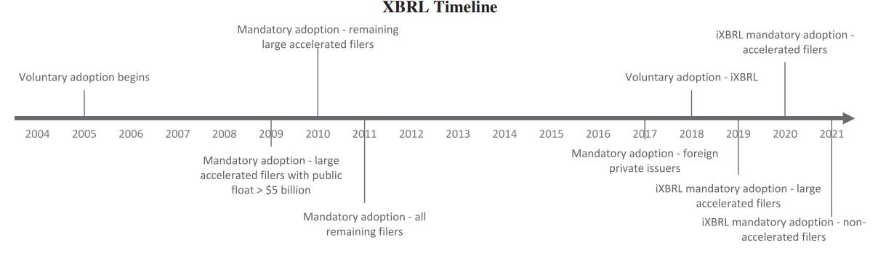
A Timeline of XBRL Requirements for Public Firms
Notes:
Source: Hoitash et al. (2021) eXtensible Business Reporting Language (XBRL): A Review and Implications for Future Research, AUDITING: A JOURNAL OF PRACTICE & THEORY Vol 40.2 pp.107-132

Slide 11
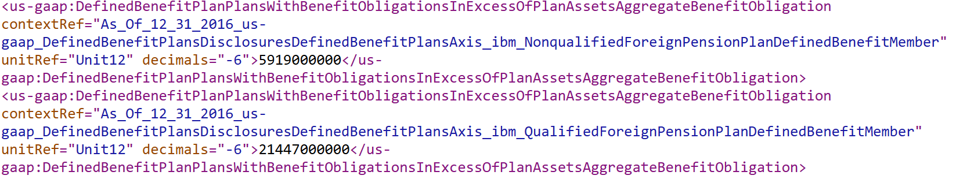
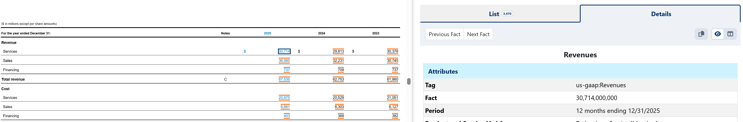
What is iXBRL?
  Inline XBRL (iXBRL) enables a single document to provide both human-readable and machine-readable data

